Slide 1
District Deputy Training

Slide 2
F Is For Forms and Forms are Fun

Slide 3
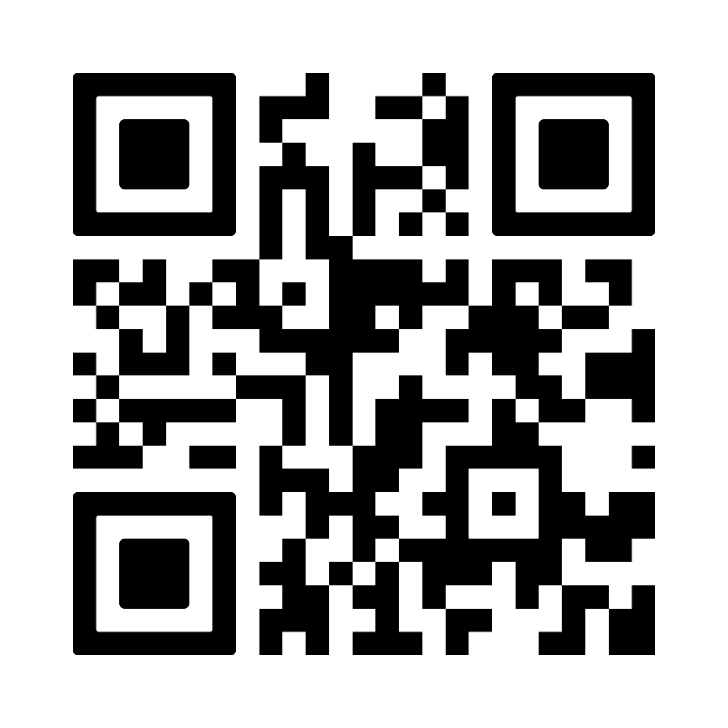
185

Slide 4
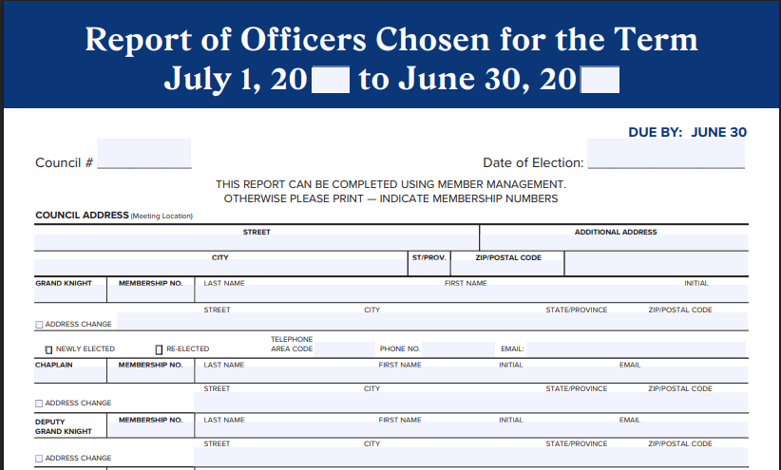
Reports to Supreme for access for Member Management
Initiates the Presidium Process
Report is due June 30th right before the new fraternal year
If submitted online, make sure the dates are for the NEXT Fraternal Year, no the current Year.
You CAN’T make Star Council without this form being subnmitted

Slide 5
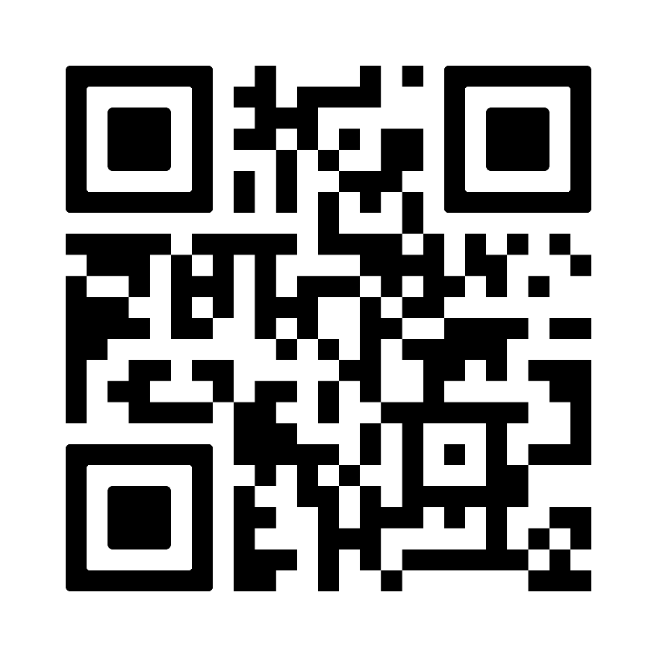
365

Slide 6
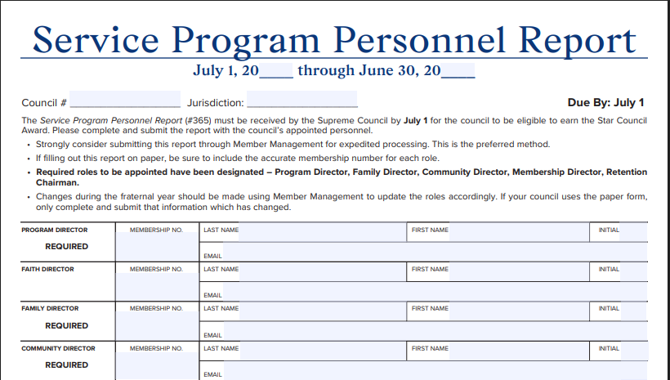
Report is due at the beginning of the Fraternal Year July 1
Initiates the Presidium Process
If submitted online, make sure the dates are for the NEXT Fraternal Year, no the current Year.
Sets your plan for the Fraternal Year, key roles and responsibilities

Slide 7
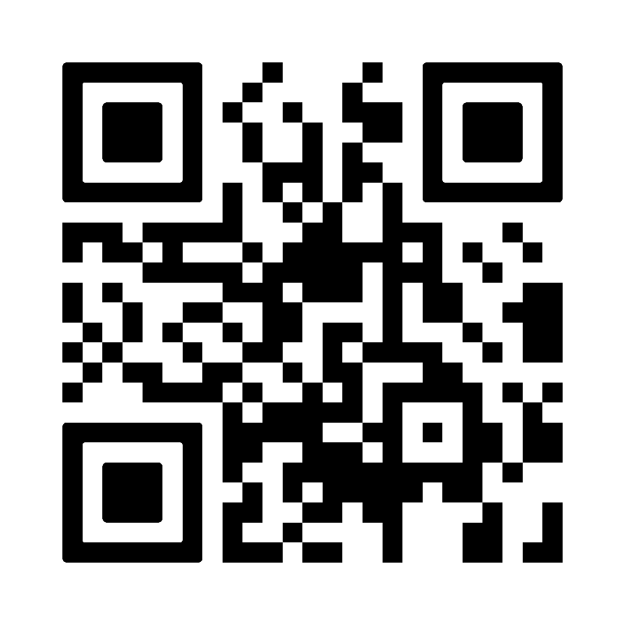
10784

Slide 8
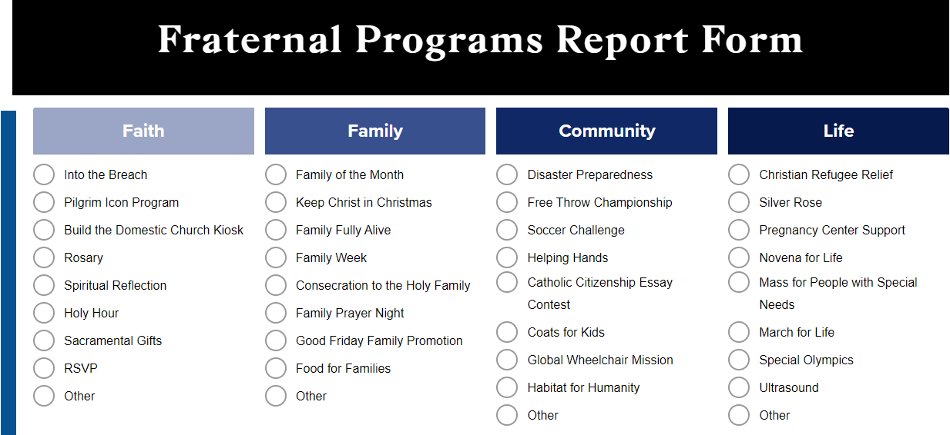
Report sent in after every program
Helps track for the SP-7 Award submission
Tells Supreme and the State we are active Councils
Any member of the Council can submit as long as they have an email on file with Supreme

Slide 9
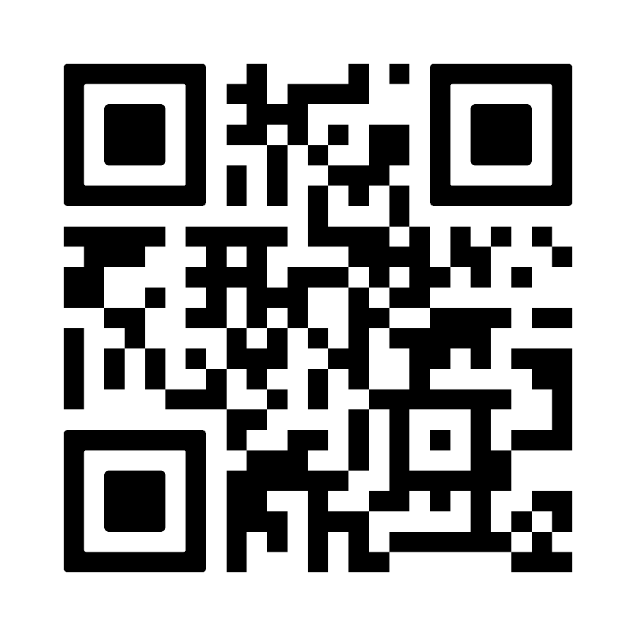
Cor Council Director

Slide 10
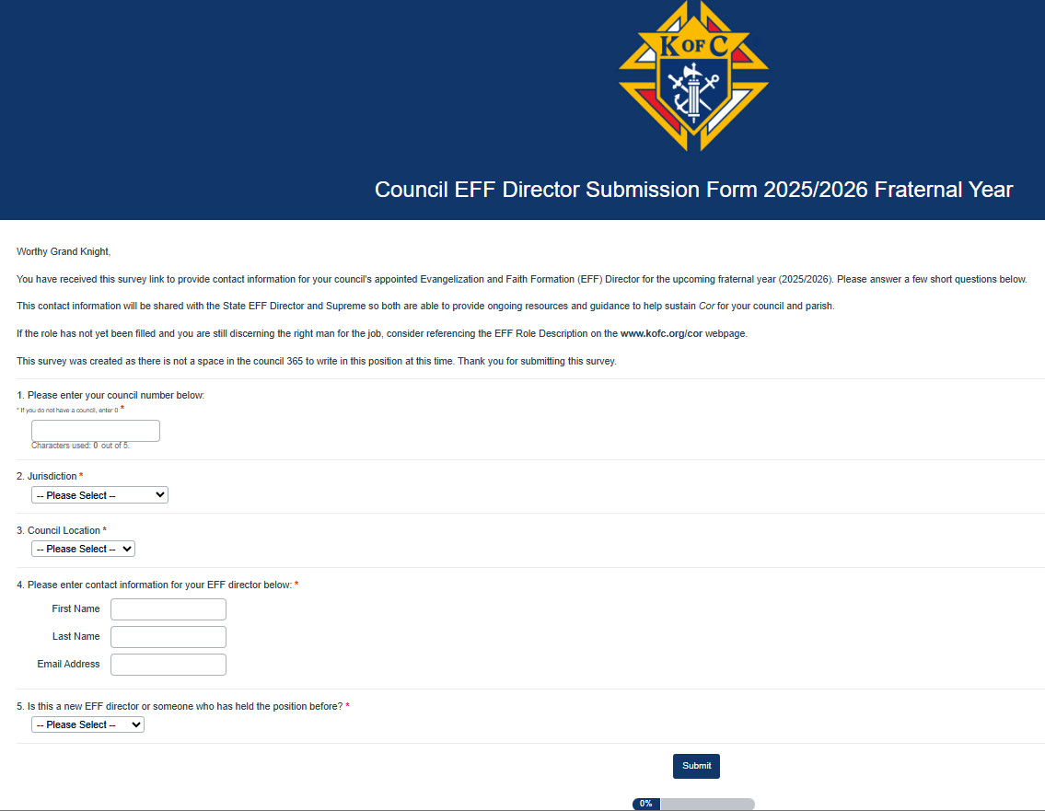
Naming your Council EFF Director is the first step to starting Cor
Supreme and the State can send direct communication on Cor activities to your Director to help them perform their position
This is one of the 3 pillars of our order, with the Program and Membership Directors

Slide 11
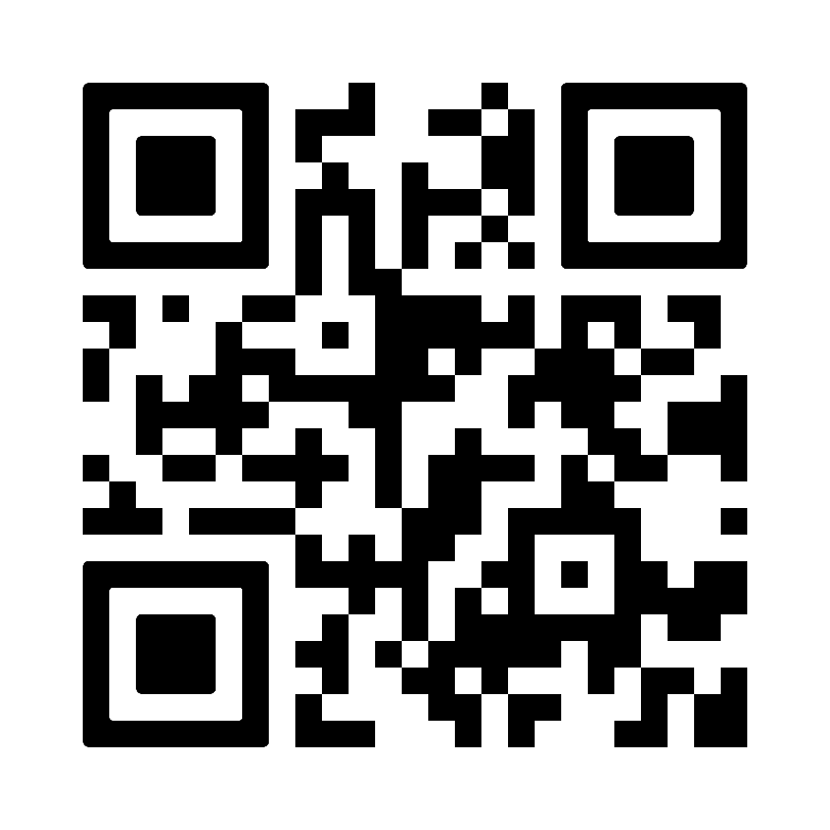
Cor Survey

Slide 12
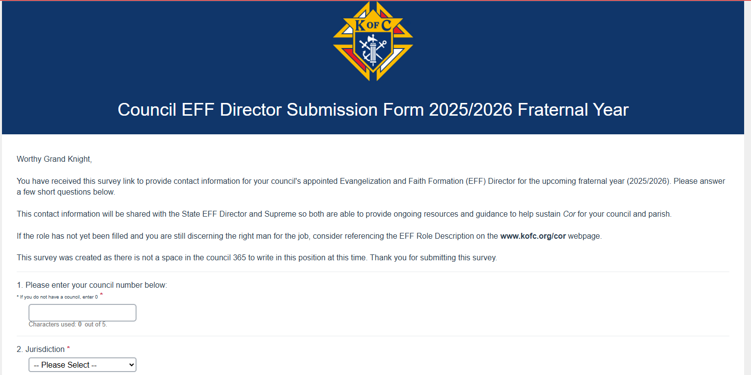
Every Cor gathering, complete this survey
Let’s the State know who is meeting and how often
The survey takes less than 2 minutes to complete
Helps you track the success of your meetings
The survey does NOT have to be completed by the EFF Director, but it is prefered

Slide 13
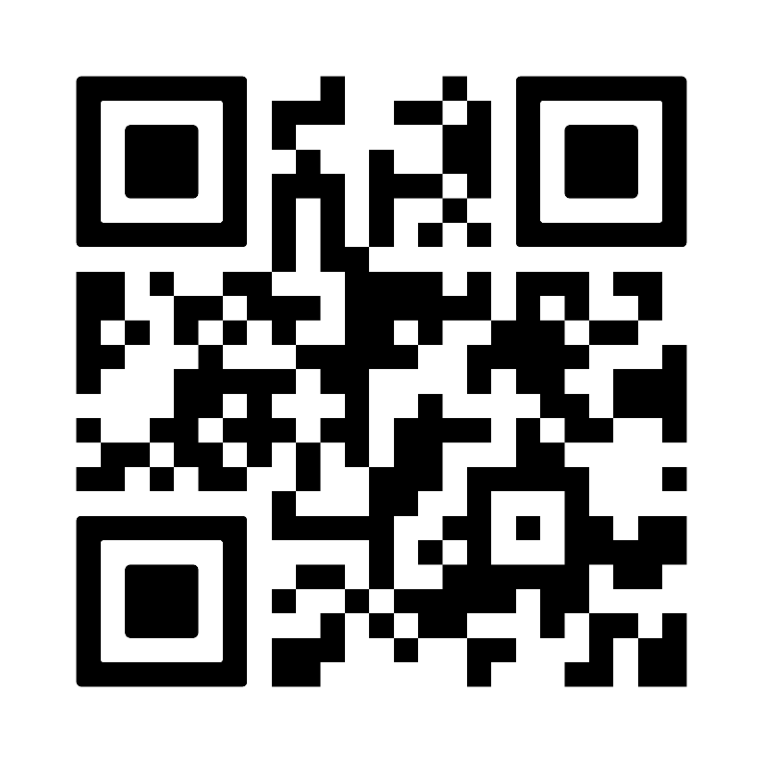
11077

Slide 14
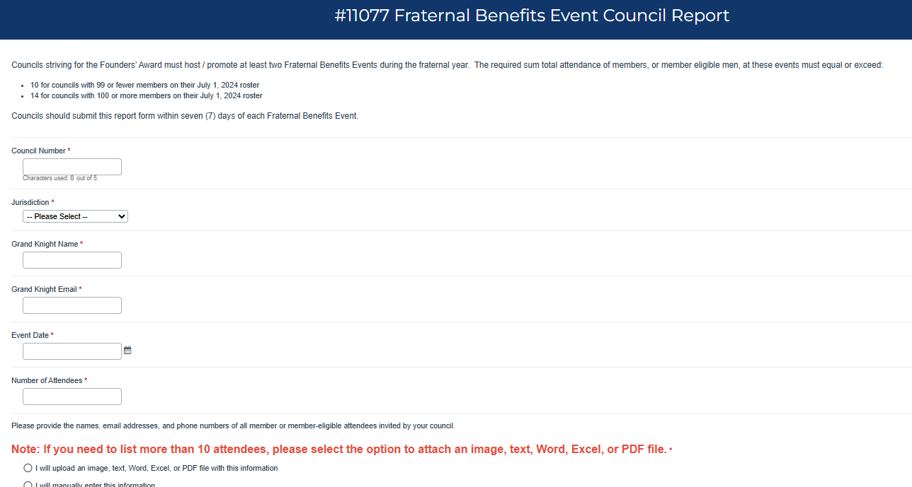
Completed within 7 days of event
Grand Knight does NOT have to complete the form, but his information needs to be in the form
You only get credit for FBN if completed properly
Attendees listed must be men over 18, catholic with name, email address & phone numbers listed

Slide 15
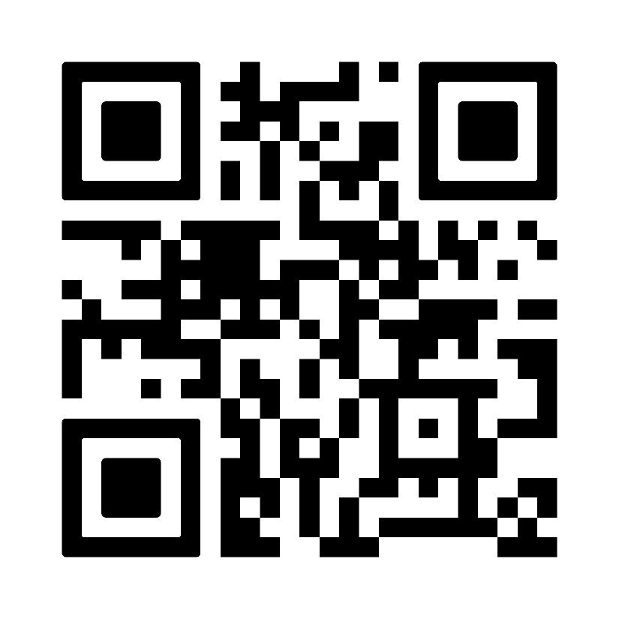
1728 Annual Survey

Slide 16
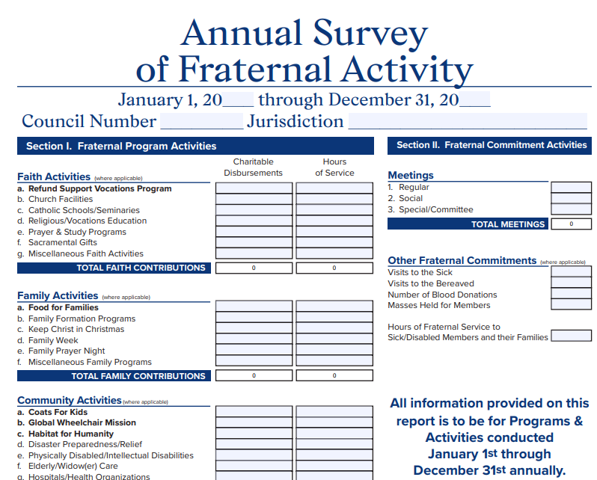
Without this survey completed, the Tax-Exempt Status of the K of C is in jeopardy
This needs to be submitted by 1/31 every year
10784 is a great resource of information to complete this survey
1728A survey of members should be taken in December to help complete this form

Slide 17
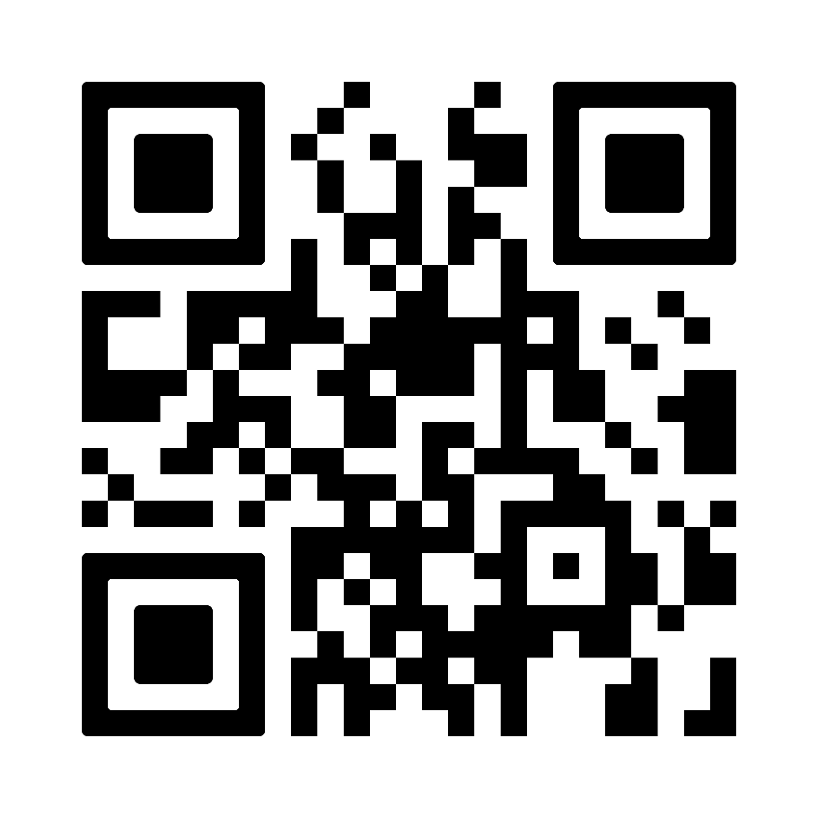
1295 September

Slide 18
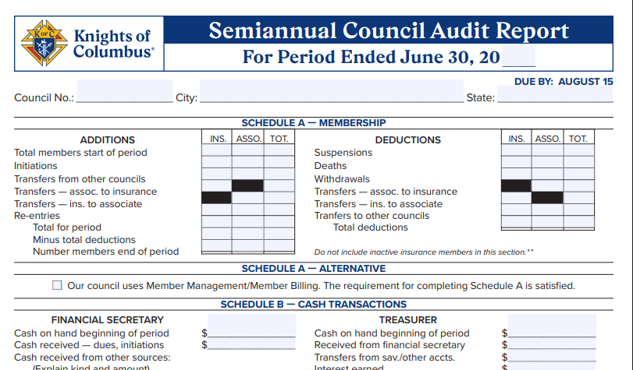
If not completed for 2 years the Council is automatically suspended from the Order
Needs to completed twice a year June 30th & December 31st
Schedule A and B BOTH need to be completed
June Report is Due 8/15

Slide 19
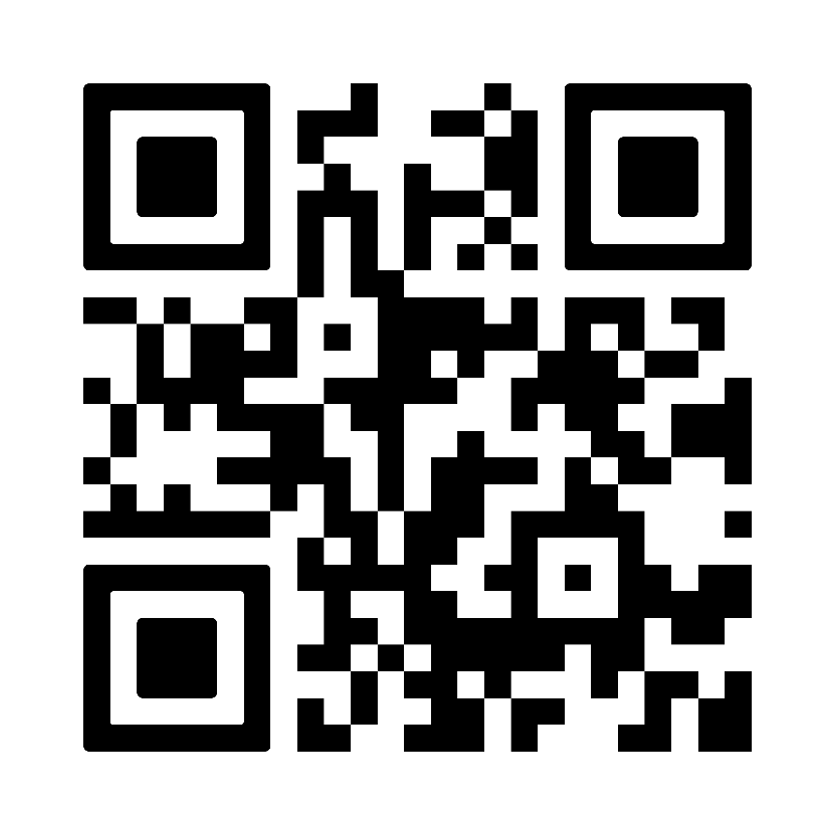
1295 February

Slide 20
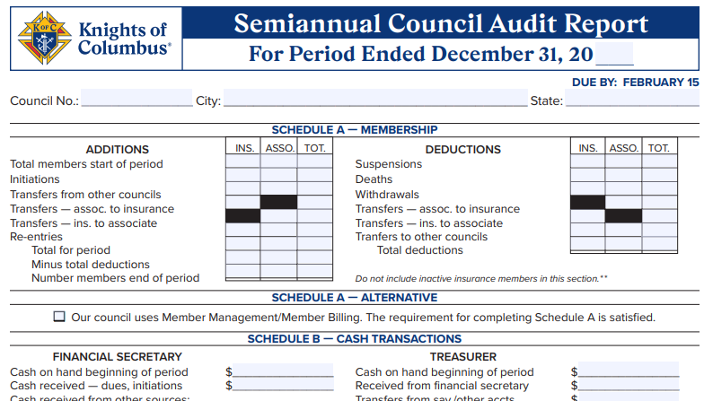
If not completed for 2 years the Council is automatically suspended from the Order
Needs to completed twice a year June 30th & December 31st
Schedule A and B BOTH need to be completed
December Report is Due 2/15

Slide 21
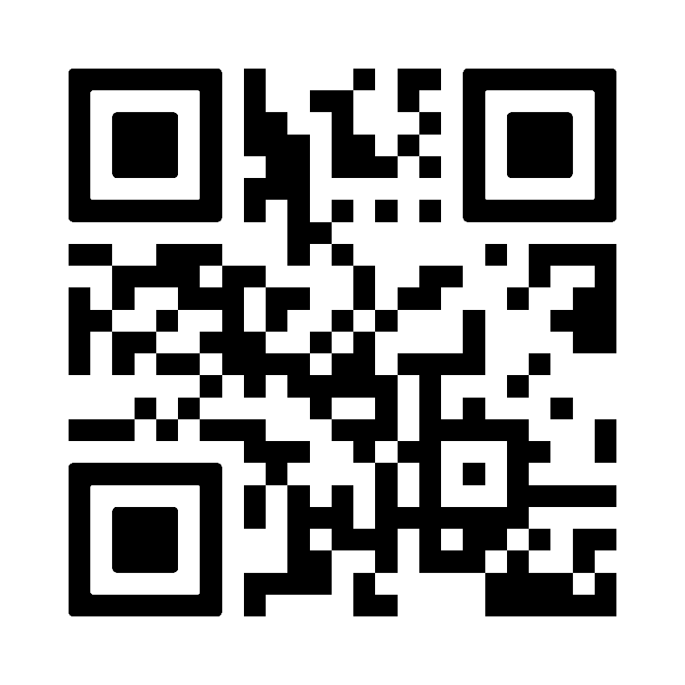
SP7 Colombian Award

Slide 22
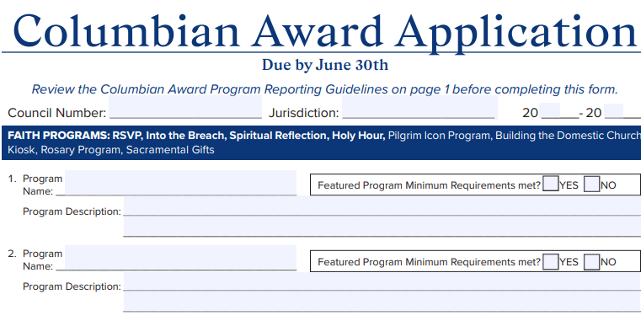
Due Prior to 6/30 Every Year
Proper completion guarantees the Columbian Award
Read Page one to Understand what a Featured Program is and what qualifies as a featured program
Nearly every Council should qualify for this Award
If they don’t you need to work with the Council before they are no longer active

Slide 23
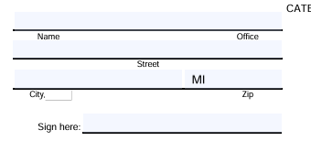
State Expense Report For All Expenses OUTSIDE of your District, (i.e. Travel to Summer Meeting)
After completing send to State Deputy Bary Borsenik @ B.Borsenik@mikofc.org
Found on the MIKOFC.ORG in Resources tab, State & Diocesan Directors Forms

Slide 24
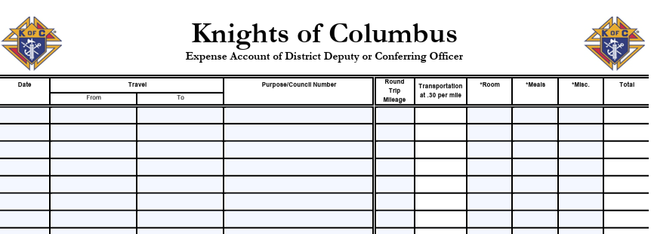
Supreme Expense Report to be Completed and sent to the State Deputy, B.Borsenik@mikofc.org for expenses in District Only Form 267DD

Slide 25
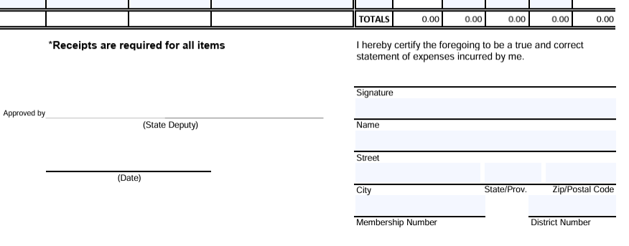
Complete the entire bottom section including signature.

